Slide 1

Exploratory Data Analysis (EDA) on Aspiring Mind Employment Outcome 2015 (AMEO) Dataset

Slide 2
About me
• My name is Deepakkumar G S I am a 3rd year B.TECH Student
• I want to pursue my carrier in data science
• LinkedIn- www.linkedin.com/in/deepak-kumar-gs
• GitHub- https://github.com/deepakgs135

Slide 3
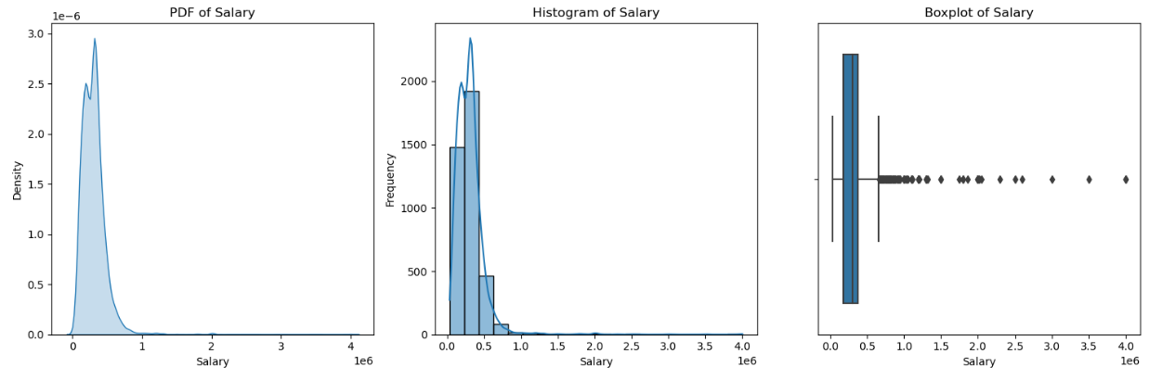
1. Introduction
The Aspiring Mind Employment Outcome 2015 (AMEO) dataset provides insights into the employment outcomes of engineering graduates. It includes various dependent and independent variables related to salary, job titles, job locations, standardized scores in cognitive, technical, and personality skills, as well as demographic features. The dataset comprises approximately 40 independent variables and 4000 data points, focusing solely on students with engineering disciplines.
2. Objective
The objective of this exploratory data analysis (EDA) is to gain insights into the AMEO dataset and understand the relationships between various independent variables and the dependent variable (Salary). Through visualization and statistical analysis, we aim to uncover patterns, trends, and potential factors influencing salary outcomes for engineering graduates.
By comparing all these data we can infer that there are 3998 rows and 39 column present in the dataset. There is no null values in the dataset. And the datatype of the each column is clearly labelled.
1.Univaiate analysis
Salary:
The graph is skewed to the left. There are more people who earn lower salaries than there are people who earn higher salaries. There is a wide range of salaries, with some people making much more than others.

Slide 4
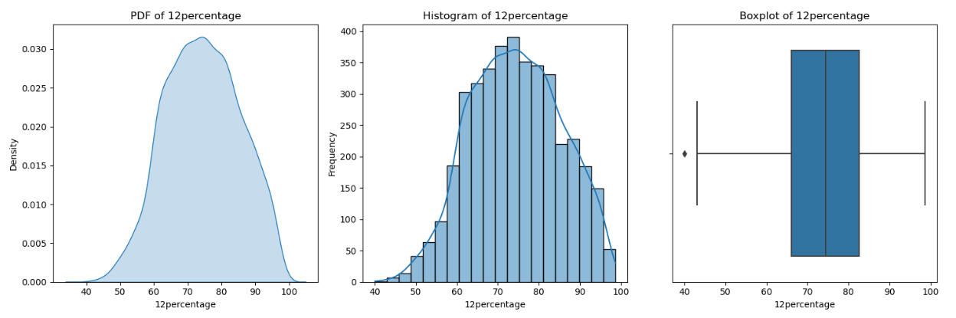
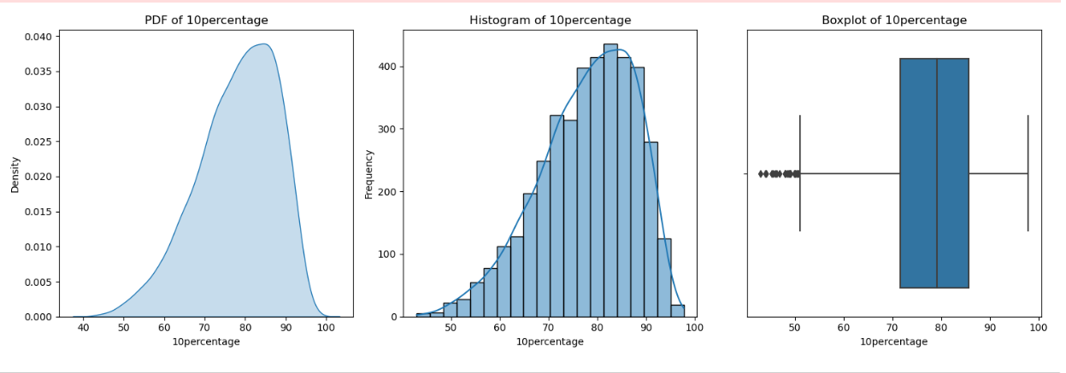
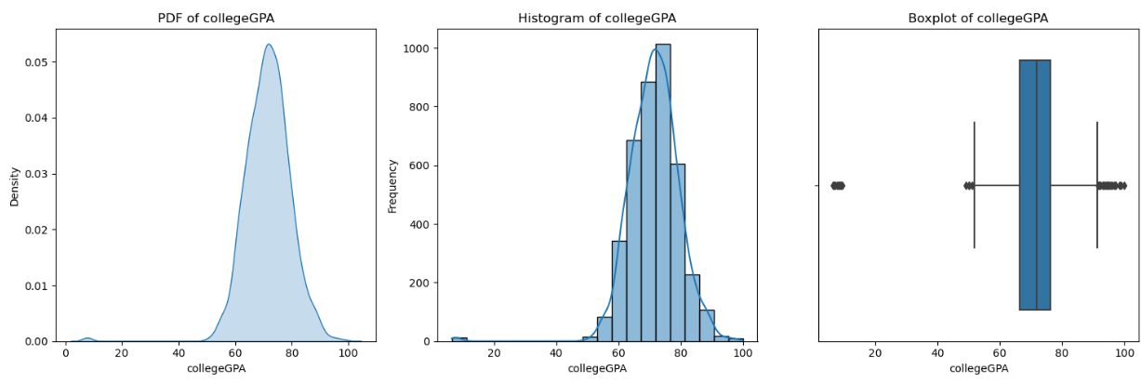
10th percentage
College-gpa
The data in the "10percentage" column appears to be right-skewed, meaning that there are more values towards the lower end of the distribution. The median, which is the value that separates the lower 50% of the data from the upper 50%, is around 65. The mean, which is the average of all the values in the data set, is likely to be even higher than this.
12th percentage
The distribution of the data is skewed to the right, meaning that there are more values at the lower end of the scale. The median value (the 50th percentile) is around 70%.There are a few outliers, which are values that are much higher than the rest of the data.
The distribution of college GPA is skewed to the right. This means that there are more students with lower GPAs than students with higher GPAs. The median GPA, represented by the line in the middle of the boxplot, is approximately 3.0. This means that half of the students have a GPA above 3.0 and half have a GPA below 3.0.

Slide 5
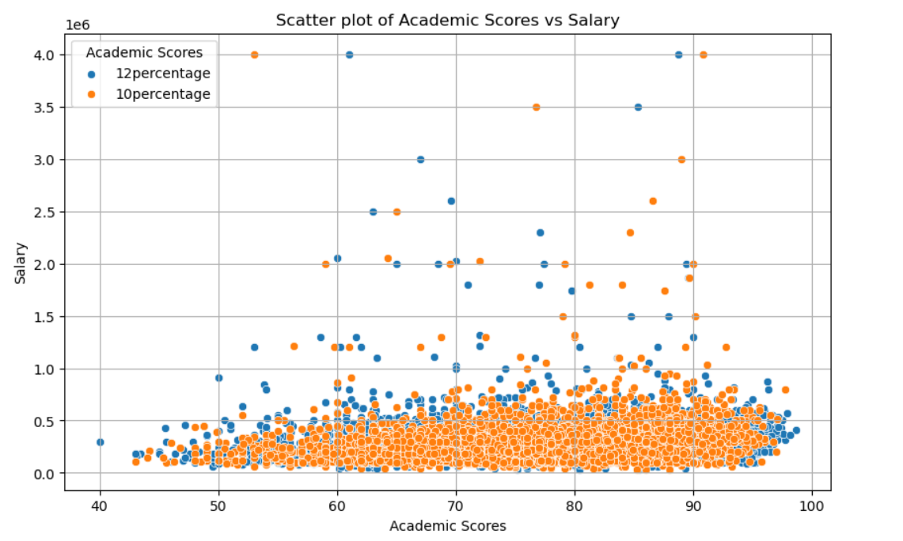
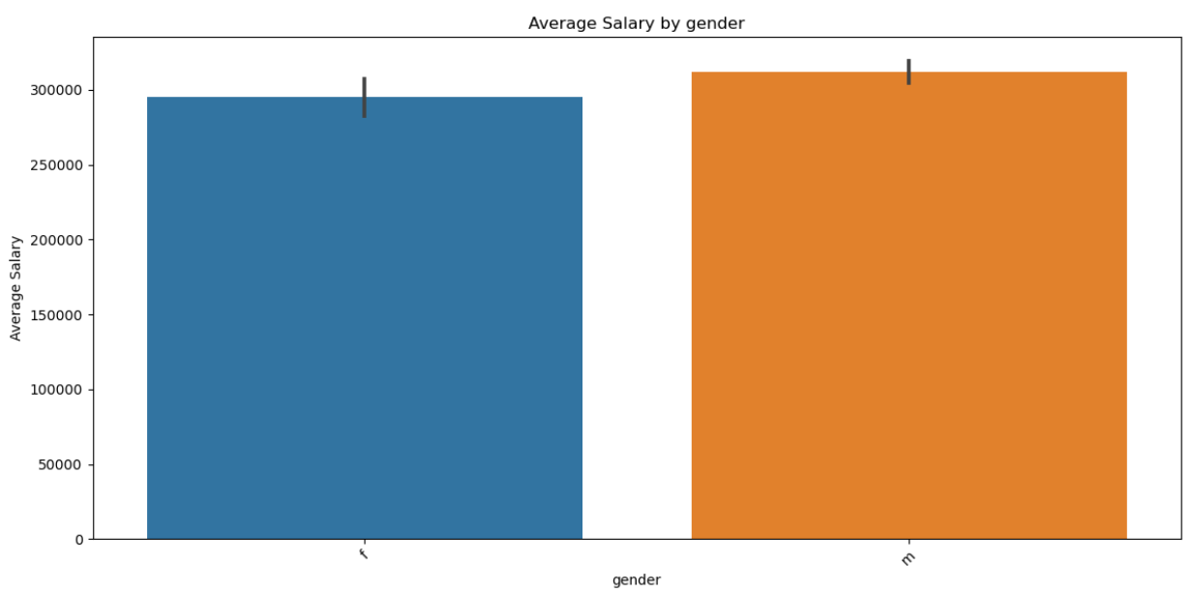
2. Bivariate analysis
Age & Salary
Academic scores and salary
There are many data points clustered in the bottom left corner of the graph, indicating that many people have lower academic scores and lower salaries. There are fewer data points in the upper right corner, indicating that fewer people have both high academic scores and high salaries.
There is a general upward trend in the data points, suggesting that people with higher academic scores tend to have higher salaries.
the average salary for men is higher than the average salary for women. The salary axis starts at $0 and goes up to $300,000 with increments of $50,000. The average salary for men is shown by the blue bar, which extends to the $250,000 mark, while the average salary for women is shown by the pink bar, which only reaches the $200,000 mark. This suggests that men earn, on average, $50,000 more than women.

Slide 6
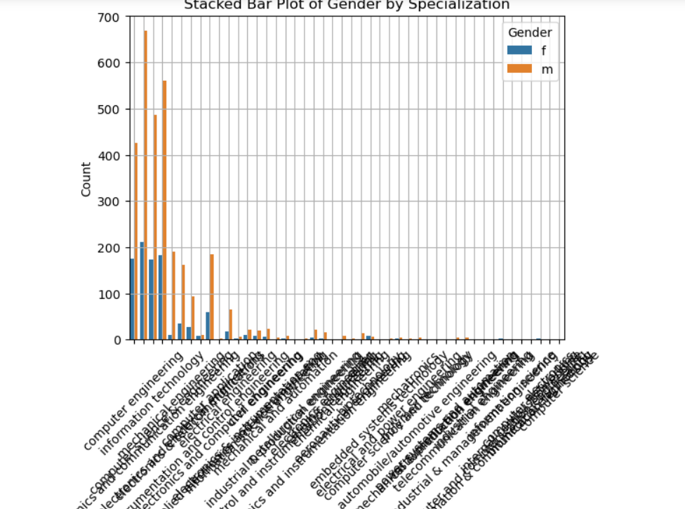
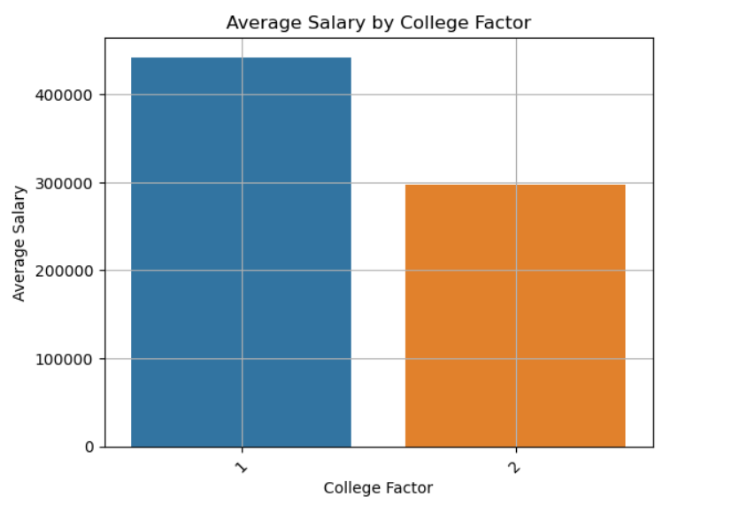
Specialization and gender
College tier and salary
There is a notable difference in the gender distribution within some specializations. For example, in computer engineering, there are almost equal numbers of males and females, while in industrial and manufacturing engineering, there are many more males than females.
There appears to be a positive correlation between college tier and salary. The average salary for graduates from top-tier colleges is around $150,000, There is a lot of overlap in the salary ranges for each college tier

Slide 7
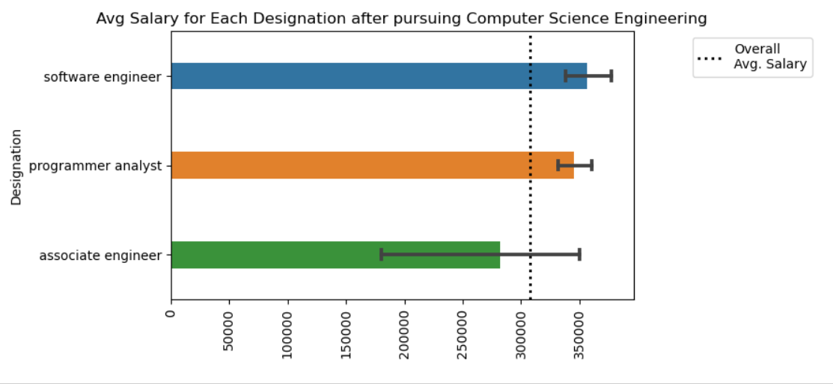
Univariate analysis
➢ First gain insights from every individual column numerical and categorical column
➢ I analyzed the data whether it is a normal distribution or not
➢ Create box plots to find outliers
➢ Treatment of outliers
➢ Use statistical and visual analysis both to understand the data
➢ Like from gender column I came to know that many males are working than female
RESEARCH OUTCOMES
“Times of India article dated Jan 18, 2019 states that “After doing your Computer Science Engineering if you take up jobs as a Programming Engineer, Analyst, Software Hardware Engineer and Associate Engineer you can earn up to 2.5 3 lakhs as a fresh graduate.”
Bivariate analysis
➢ In Bivariate analysis I compared two columns with different plots like Scatter chart ,Barplot, Boxplots
➢ I compared gender vs salary , gender vs specialization , gender vs designation , gender vs specialization vs salary , salary vs cgpa etc.
➢ In bivariate analysis I compared categorical vs categorical , numerical vs numerical , categorical vs numerical
The analysis begins by grouping the dataset by job designation, calculating the mean and standard deviation of salaries for each job role. This provides insights into salary distribution across different designations.

Slide 8
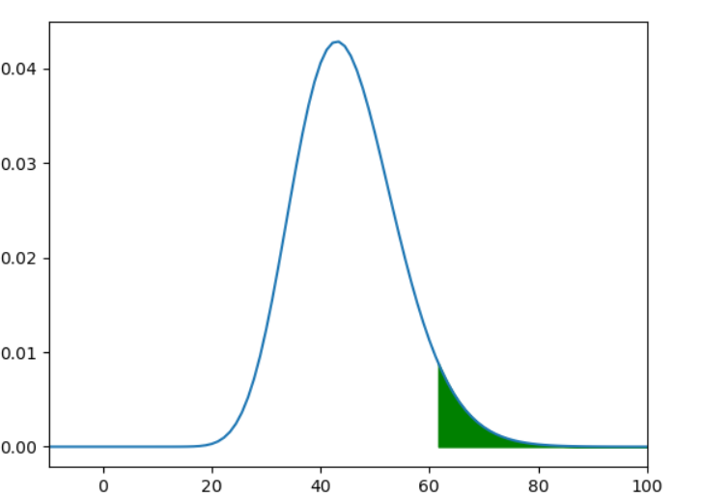
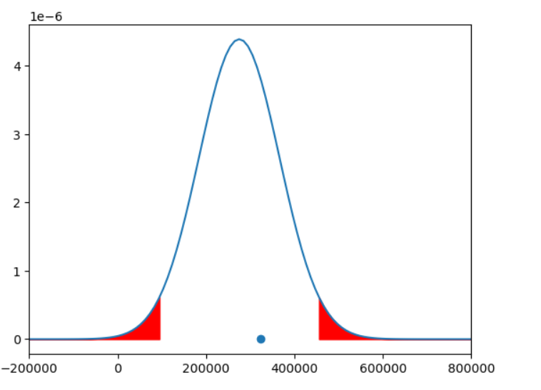
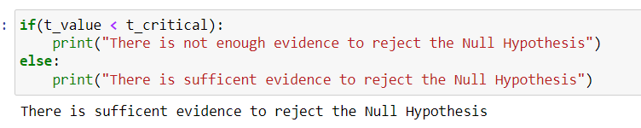
Notably, Software Engineers have the highest mean salary and standard deviation, indicating both higher earnings and variability in pay compared to Programmer Analysts and Associate Engineers
Is there a relationship between gender and specialization? (i.e. Does the preference of Specialization depend on the Gender?)
The analysis conducted using a Chi Square test examined the relationship between gender and specialization preferences. The test revealed a statistically significant relationship between the two variables, indicating that specialization preferences are dependent on gender.
Following this, a one-sample t-test is conducted for each job designation to compare their average salary against an expected range.

Slide 9
Conclusion
The dataset encompasses the employment outcomes of engineering graduates, focusing on target variable “Salary”.
Additionally, it includes standardized scores in three distinct areas:
cognitive skills
personality skills
technical skills
Upon initial observation, the dataset consists of 4000 rows and 40 columns. The dataset exhibits numerous duplicate values, necessitating data manipulation. Initially, we remove redundant rows and columns. Subsequently, we assess for the presence of any missing values (NaN). Following data cleaning, we proceed with visualization.
- Univariate analysis encompasses various plots, including Cumulative Distribution Functions (CDF), Histograms, Box Plots, and Summary Plots.
- These visualizations illustrate probability and frequency distributions.
- Bivariate analysis comprises Scatterplots, Barplots, Crosstabs, Pivot tables, pie charts.
- This analysis helps in comparing percentages across different variables.
- Additionally, it aids in identifying outliers, as observed through Boxplots.
- For instance, Count plots assist in identifying outliers within categorical variables, such as Job City, by highlighting the cities with higher

Slide 10

THANK YOU

